Slide 1
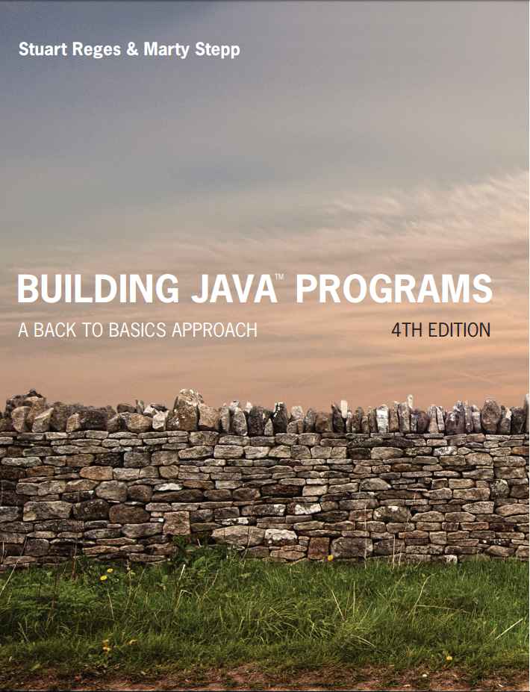
Building Java Programs
Fourth Edition
Chapter 4, Section 4.1
Conditional Execution
Copyright © 2017, 2014, 2011 Pearson Education, Inc. All Rights Reserved
Notes:
If this PowerPoint presentation contains mathematical equations, you may need to check that your computer has the following installed:
1) MathType Plugin
2) Math Player (free versions available)
3) NVDA Reader (free versions available)

Slide 2
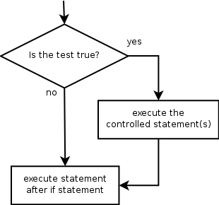
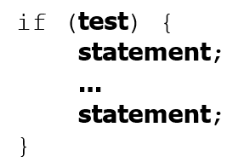
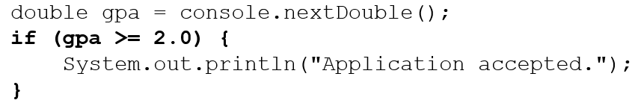
The if Statement
Executes a block of statements only if a test is true
Example:

Slide 3
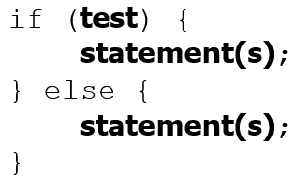
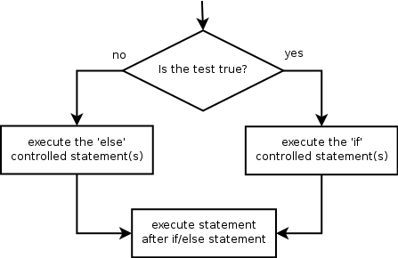
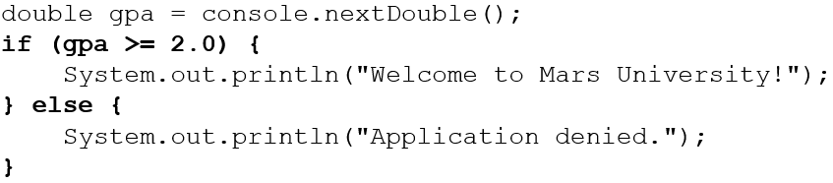
The if/else Statement
Executes one block if a test is true, another if false
Example:

Slide 4

Relational Expressions
if statements and for loops both use logical tests.
These are boolean expressions, seen in Ch. 5.
Tests use relational operators:
Operator | Meaning | Example | Value
== | equals | 1 + 1 == 2 | true
!= | does not equal | 3.2 != 2.5 | true
< | less than | 10 < 5 | false
> | greater than | 10 > 5 | true
<= | less than or equal to | 126 <= 100 | false
>= | greater than or equal to | 5.0 >= 5.0 | true
Notes:
Note that == tests equality, not = . The = is used for the assignment operator!

Slide 5
In-Class Assignment 1, Part 1
Create the class MathOps in BluJ
In the main program, do the following:
Prompt the user to input two double values, one at a time
Prompt the user to input a character (one letter)
If the character is ‘A’, add the two numbers and output the sum.
If the character is anything else, subtract the two numbers and output the difference.

Slide 6
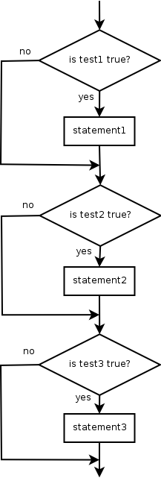
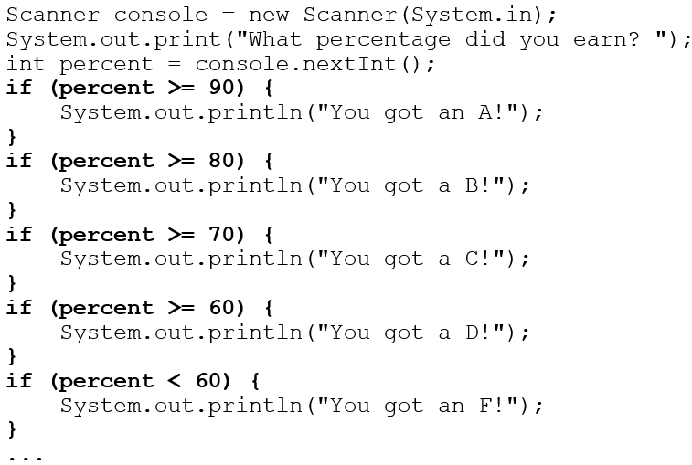
Misuse of if
What’s wrong with the following code?

Slide 7
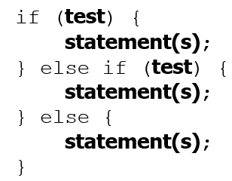
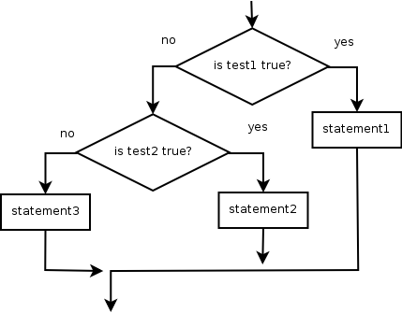
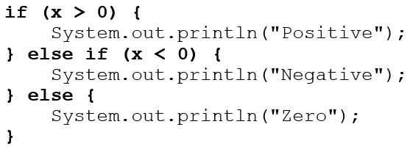
Nested if/else
Chooses between outcomes using many tests
Example:

Slide 8
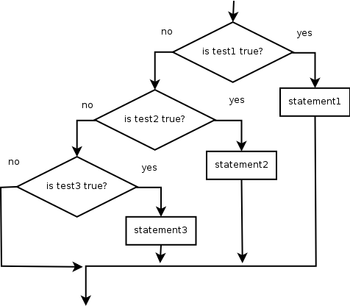
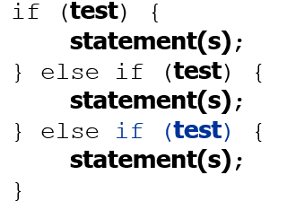
Nested if/else/if (1 of 2)
If it ends with else, exactly one path must be taken.
If it ends with if, the code might not execute any path.

Slide 9
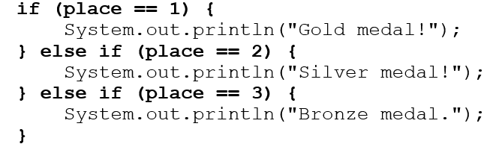
Nested if/else/if (2 of 2)
Example:

Slide 10
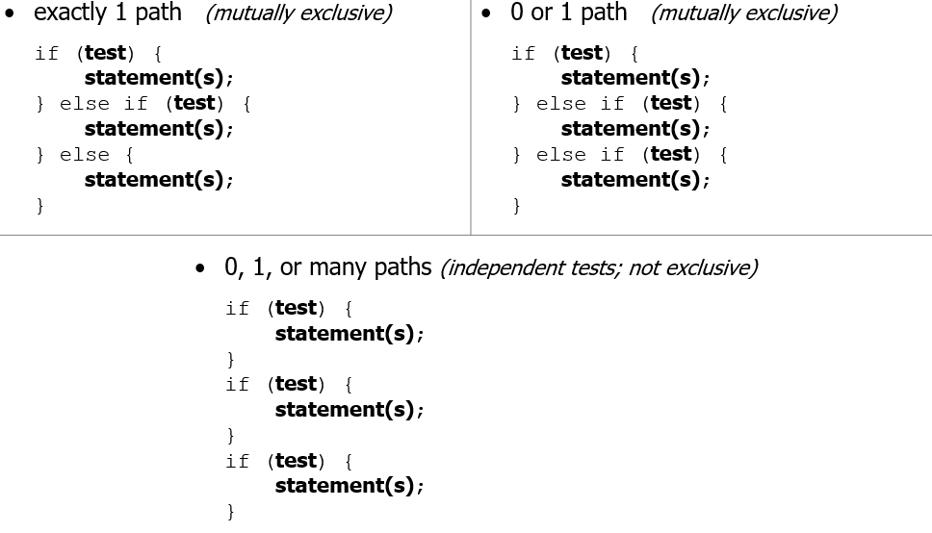
Nested if Structures

Slide 11
In-Class Assignment 1, Part 2
Update the main program in the MathOps class to do the following:
After entering the two double values and the character:
If the character is ‘a’, add the two numbers and output the sum.
If the character is ‘s’, subtract the two numbers and output the difference
If the character is ‘m’, multiply the two numbers and output the difference
If the character is ‘d’, divide the two numbers and output the quotient
If the character is any other letter, display a message saying the operation was invalid.

Slide 12
Which Nested if/else?
(1) if/if/if (2) nested if/else (3) nested if/else/if
Whether a user is lower, middle, or upper-class based on income.
(2) nested if / else if / else
Whether you made the dean’s list (G P A ≥ 3.8) or honor roll (3.5-3.8).
(3) nested if / else if
Whether a number is divisible by 2, 3, and/or 5.
(1) sequential if / if / if
Computing a grade of A, B, C, D, or F based on a percentage.
(2) nested if / else if / else if / else if / else

Slide 13
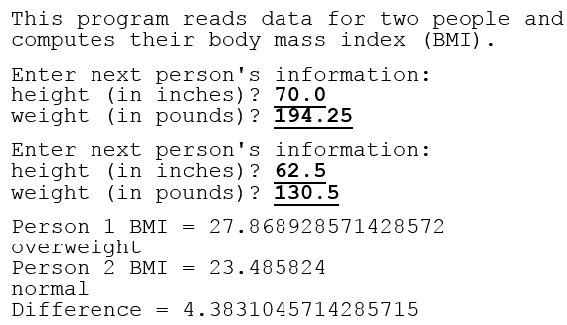
Nested if/else Question
Formula for body mass index (B M I):
B M I | Weight class
below 18.5 | underweight
18.5 - 24.9 | normal
25.0 - 29.9 | overweight
30.0 and up | obese
Write a program that produces output like the following:
Notes:
// This program computes two people's body mass index (BMI) and
// compares them. The code uses parameters, returns, and Scanner.
import java.util.*; // so that I can use Scanner
public class BMI {
public static void main(String[] args) {
System.out.println("This program reads in data for two people and");
System.out.println("computes their body mass index (BMI)");
System.out.println();
// finish me!
}
}

Slide 14
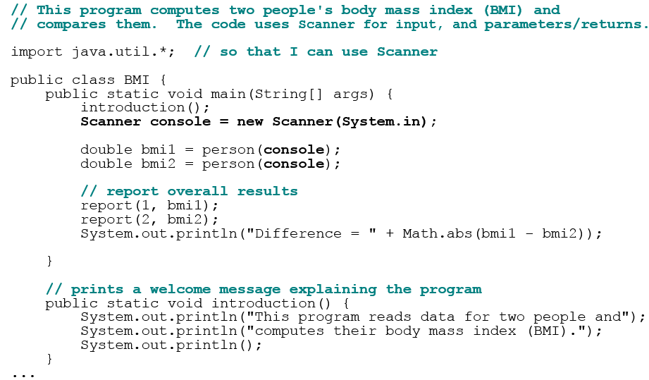
Nested if/else Answer (1 of 2)

Slide 15
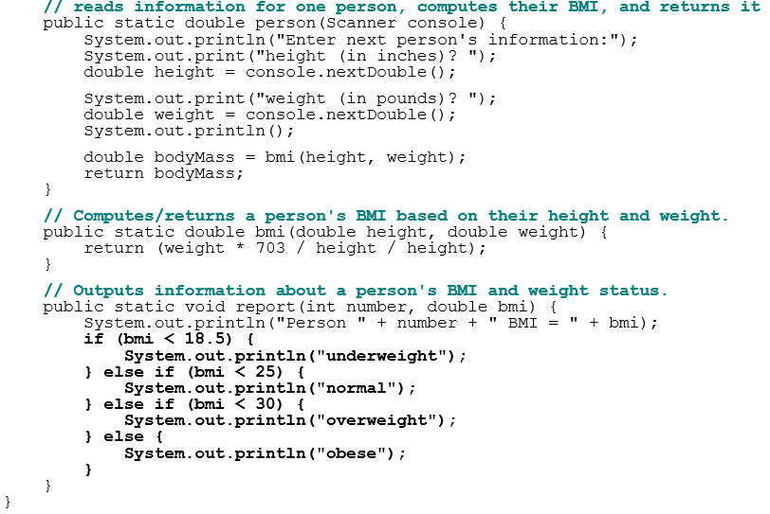
Nested if/else Answer (2 of 2)
Notes:
How would we round the BMI numbers?

Slide 16
Logical Operators
Tests can be combined using logical operators:
Operator | Description | Example | Result
&& | and | (2 == 3) && (-1 < 5) | false
|| | or | (2 == 3) || (-1 < 5) | true
! | not | !(2 == 3) | true
“Truth tables” for each, used with logical values p and q:
p | q | p && q | p || q
true | true | true | true
true | false | false | true
false | true | false | true
false | false | false | false
p | !p
true | false
false | true

Slide 17
Evaluating logic expressions (1 of 2)
Relational operators have lower precedence than math.

Slide 18
Evaluating logic expressions (2 of 2)
Relational operators cannot be “chained” as in algebra.
2 <= x <= 10
true <= 10 (assume that x is 15)
error!
Instead, combine multiple tests with && or ||
2 <= x && x <= 10
true && false
false

Slide 19
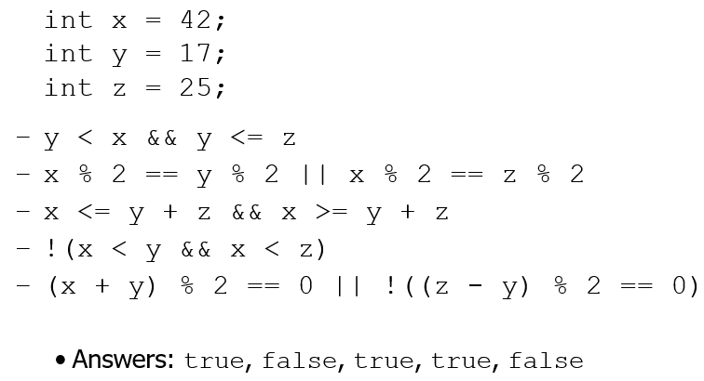
Logical Questions
What is the result of each of the following expressions?
Exercise: Write a program that prompts for information about a person and uses it to decide whether to date them.

Slide 20
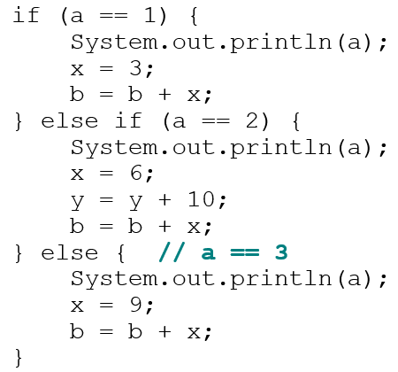
Factoring if/else Code
factoring: Extracting common/redundant code.
Can reduce or eliminate redundancy from if/else code.
Example:
System.out.println(a);
x = 3 * a;
if (a == 2) {
y = y + 10;
}
b = b + x;

Slide 21
In-Class Assignment 1, Part 3
Update the main program in the MathOps class to do the following:
Change the conditions in the if statements so that both upper case and lower case letters are checked.
When checking for division, add a third check to make sure the second number entered is not 0.

Slide 22

Copyright

